Slide 1


Mesa Airlines, Inc. E-175
Fueling Procedures Training

Slide 2
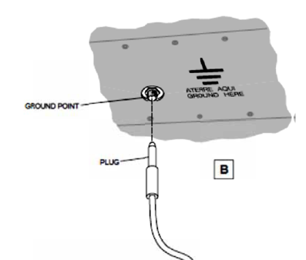
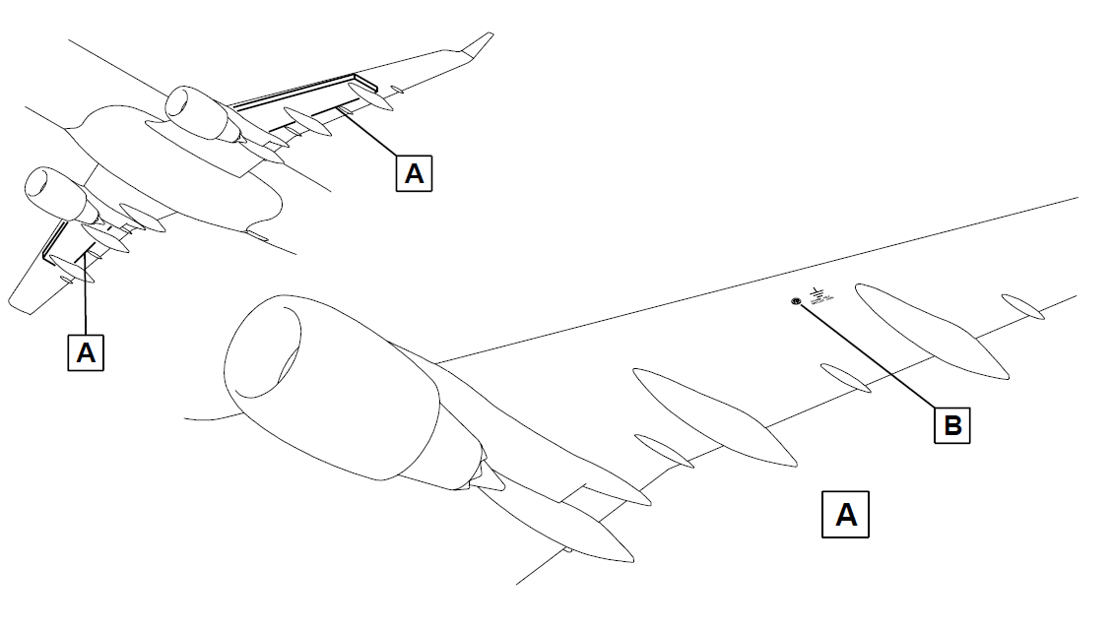
Electrostatic Bonding
Always bond an aircraft prior to starting the fueling operation to prevent an electric spark.
The fuel tender, aircraft and nozzle MUST be bonded.
Warning: A static electric spark could cause an explosion or a fire.

Slide 3
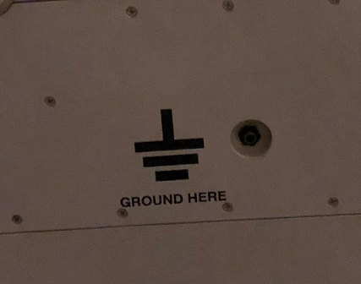
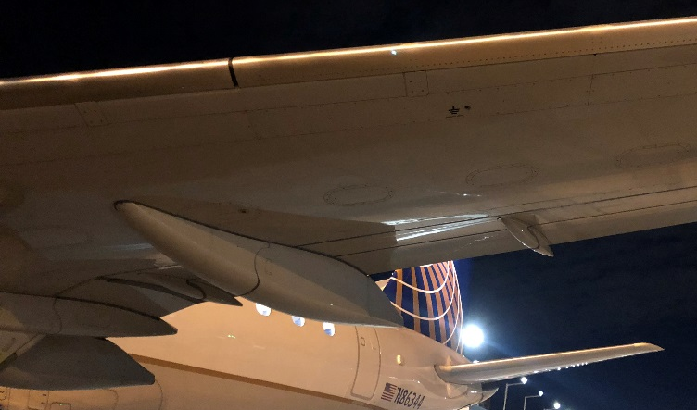
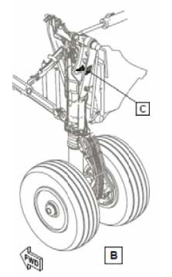
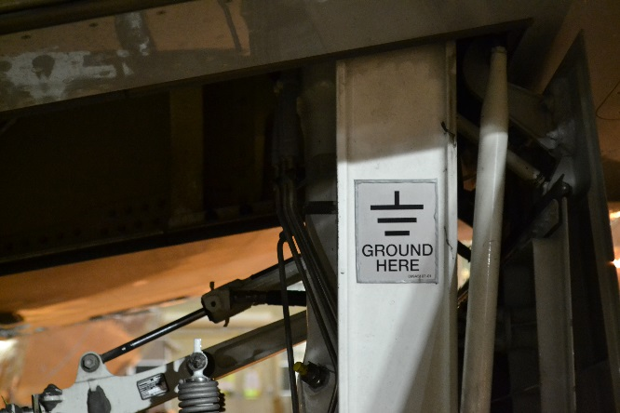
E-175 Bonding Locations
The E-175 has 3 approved bonding locations:
  Left or Right Wing Leading Edge
  Right Main Landing Gear
The ports on the underside of the wing are “plug” style and can be bonded using a bayonet connector.
(Pictured: top)
The right main landing gear has a metal clip that a “clamp” style connector can be secured to.
(Pictured: bottom, facing forward)

Slide 4
E-175 Tank Specifications
Tank Capacities
Location | Usable Fuel | Unusable Fuel | Total Volume
Left Main Tank | 10392.5 lbs. (4714 kg) | 75 lbs. (34 kg) | 10467.5 lbs. (4748 kg)
Right Main Tank
Total Fuel Capacity (both tanks combined) | 20935 lbs. (9495.5 kg)
When fueling, always monitor the tank quantities. The imbalance of fuel between the left and right main tanks must NEVER exceed 794 lbs. If this limit is exceeded, the aircraft could shift causing injury or damage to equipment and the aircraft.
Maximum Tank Imbalance
E-175 | 794 lbs. (360 kg)

Slide 5
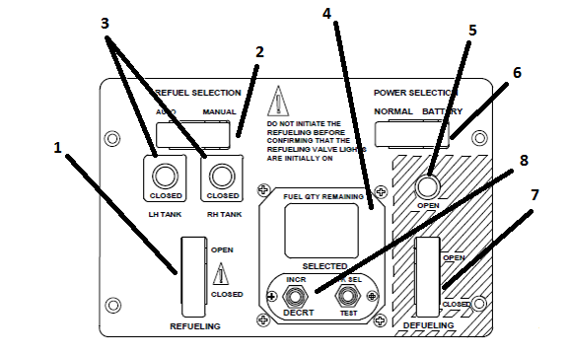
E-175 Fuel Control Panel
REFUELING Switch
REFUEL SELECTION Switch
LH/RH REFUELING Indication Lights
Repeater Indicator
DEFUELING Indication Light
POWER SELECTION Switch
DEFUELING Switch
INCR/DECRT Switch

Slide 6
Automatic Refueling
First, ensure the aircraft is properly bonded via an approved bonding method, and open the fuel panel under the wing.
Make sure the REFUELING switch (1) and the DEFUELING switch (7) are both in the CLOSED position.
Confirm the LH and RH refueling indication lights (3) are off.
Make sure the defueling indication light (5) is off.
Set the REFUEL SELECTION switch (2) to the AUTO position.
Set the repeater indicator (4) to the necessary fuel quantity using the INCR/DECRT switch (8).
Automatic mode should always be used when operational.

Slide 7
Automatic Refueling
Remove the cap from the fuel adaptor (fuel hose connector).
Visually check for contamination or cracks in the fuel connectors.
  If any contamination is present, contact the flight crew.
Connect the fuel nozzle to the fuel adaptor.
Pressurize the fuel system to 40± PSI (276± kPa).
Make sure the LH and RH refueling indication lights (3) come on and there is no fuel flow.
THE NOZZLE MUST NEVER BE PRESSURIZED ABOVE 50 PSI (345 kPa)

Slide 8
Automatic Refueling
Set the REFUELING switch (1) to the OPEN position, and make sure the LH and RH refueling indication lights (3) go off.
When the necessary fuel quantity is obtained, the LH and RH refueling indication lights (3) will come on and the fuel flow stop.
Stop the fueling if the screen blacks out or if STOP R OVER, STOP L OVER or STOP L/R OVER appears.
If this precaution is not obeyed, fuel leaks can occur and/or cause damage to the aircraft.
WHEN FUELING, CONTINOUSLY MONITOR THE TANK QUANTITIES TO ENSURE THE MAXIMUM TANK IMBALANCE IS NOT EXCEEDED ON THE MAIN TANKS.

Slide 9
Automatic Refueling
Set the REFUELING switch (1) to the CLOSED position.
  If the aircraft batteries were used, move the POWER SELECTION switch (6) from BATTERY back to the NORMAL position.
Remove pressure from the fuel nozzle to 0 PSI (0 kPa).
Disconnect the fuel nozzle from the fuel adaptor.
Install the cap on the fuel adaptor and securely latch the open panel. Disconnect the bonding connection from the aircraft.

Slide 10
Manual Refueling
If the automatic mode is unavailable, manual pressure refueling is permitted.
All set-up procedures and safety precautions to prepare for automatic refueling must be followed for manual refueling.

Slide 11
Manual Refueling
First, ensure the aircraft and fuel tender are bonded via an approved method.
Open the refueling panel and check to make sure:
  The LH and RH refueling indication (3) and defueling indication (5) lights are all off.
  Verify the REFUELING Switch (1) is CLOSED.
Set the REFUEL SELECTION switch (2) to the MANUAL position.

Slide 12
Manual Refueling
Remove the cap from the fuel adaptor.
Visually check for contamination or cracks in the fuel connectors.
  If any contamination is present, contact the flight crew.
Connect the fuel nozzle to the fuel adaptor.
Pressurize the fuel system to 40± PSI (276± kPa).
Make sure the LH and RH refueling indication lights (3) come on and there is no fuel flow.
THE NOZZLE MUST NEVER BE PRESSURIZED ABOVE 50 PSI (345 kPa)

Slide 13
Manual Refueling
Set the REFUELING switch (1) to the OPEN position and make sure that the LH and RH refueling indication lights (3) go off.
When the necessary fuel quantity is obtained, set the REFUELING switch (1) to the CLOSED position.
Make sure that the LH and RH refueling indication lights (3) come on and the fuel flow stops.
WHEN FUELING, CONTINOUSLY MONITOR THE TANK QUANTITIES TO ENSURE THE MAXIMUM TANK IMBALANCE IS NOT EXCEEDED ON THE MAIN TANKS.
Stop the fueling if the screen blacks out or if STOP R OVER, STOP L OVER or STOP L/R OVER appears.
If this precaution is not obeyed, fuel leakage can occur and cause damage to the aircraft.

Slide 14
Manual Refueling
At the desired fuel quantity, set the REFUELING switch (1) to the CLOSED position. Ensure the LH and RH indication lights (3) come on and the fuel flow stops.
Remove pressure from the fuel nozzle to 0 PSI (0 kPa).
Disconnect the fuel nozzle from the fuel adaptor.
Install the cap on the fuel adaptor and securely latch the open panel. Disconnect the bonding connection from the aircraft.

Slide 15
Gravity Refueling (Overwing)
If the pressure refueling system is unavailable or inoperative, gravity (overwing) refueling is permitted.
All procedures and safety precautions to prepare for automatic/manual refueling must be followed for gravity (overwing) refueling.
Solid protective wing mats MUST be utilized to prevent damage and scratches to the wing surface. Mesh or “bar” mats are NOT acceptable.

Slide 16
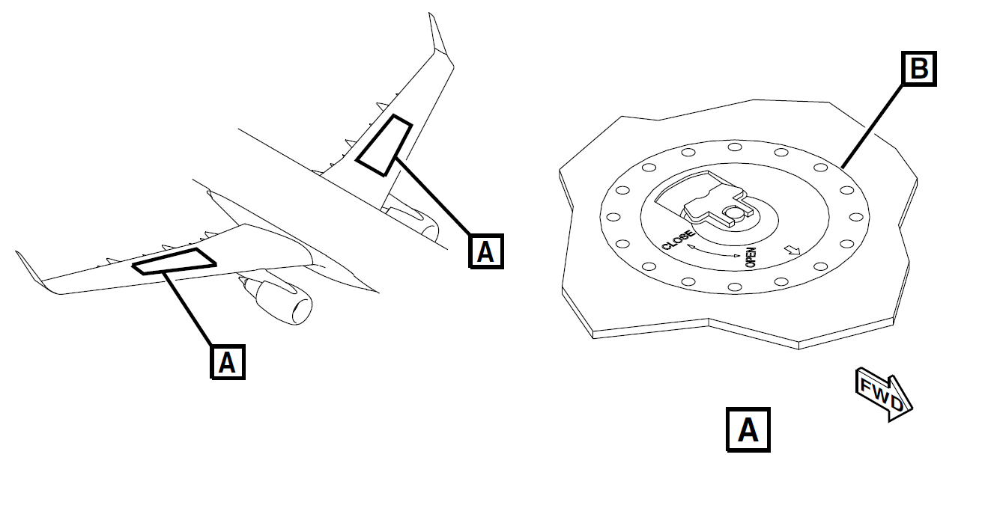
Gravity Refueling
First, ensure the fuel tender and aircraft are bonded via an approved method.
For the LH fuel tank, open the LH gravity filler cap.
For the RH fuel tank, open the RH gravity filler cap.

Slide 17
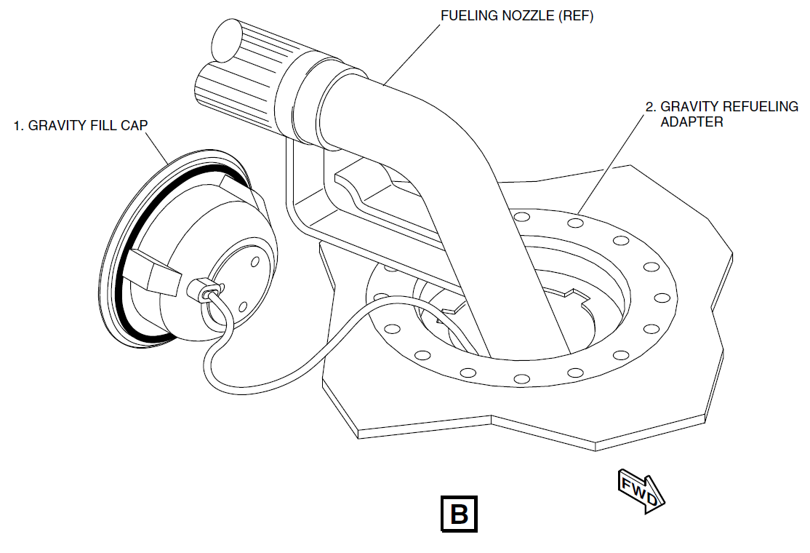
Gravity Refueling
Put the fuel nozzle into the
gravity filler port.
Begin dispensing the fuel and
monitor the fuel quantity
in the tank(s).
The tanks may be fueled one at a time, provided the maximum tank imbalance is not exceeded. Fueling both tanks at the same time utilizing two fuelers is also permitted.
WHEN FUELING, CONTINOUSLY MONITOR THE TANK QUANTITIES TO ENSURE THE MAXIMUM TANK IMBALANCE IS NOT EXCEEDED ON THE MAIN TANKS.

Slide 18
Gravity Refueling
Remove the fueling nozzle from the gravity filler port after obtaining the correct fuel quantity in the tank(s). Replace the gravity filler cap(s).
Latch any open panels securely shut and disconnect the bonding connection from the aircraft.

Slide 19
Suction Defueling
When defueling, observe all safety precautions.
Only suction defueling is permitted without Maintenance personnel present. For gravity defueling, contact Mesa Dispatch.
The aircraft must be connected to ground power.
  If external ground power is not available, aircraft batteries may be used.
Ensure the aircraft and fuel tender are properly bonded and open the fuel panel.

Slide 20
Suction Defueling
Make sure the refueling (3) and defueling (5) indication lights are off and the REFUELING Switch (1) is CLOSED.
Remove the cap from the fuel adaptor and connect the fuel nozzle.
Open the valve handle on the fuel nozzle.
Set the DEFUELING switch (7) to the OPEN position, and make sure that the defueling indication light (5) comes on.

Slide 21
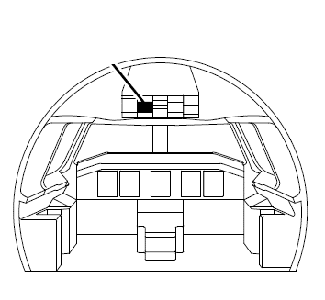
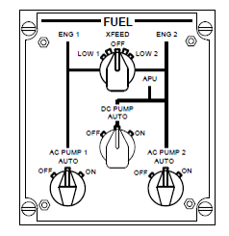
Suction Defueling
In the flight deck, a second agent will locate the overhead FUEL CONTROL PANEL.
Set the XFEED switch as follows:
  To defuel both tanks, set to the LOW 2 position
  To defuel only the LH tank, set to the OFF position
  To defuel only the RH tank, set to the LOW 1 position.

Slide 22
Suction Defueling
Apply suction to defuel and do not exceed -4 PSI (-27 kPa).
When the desired tank quantities are reached, set the DEFUELING switch (7) to the CLOSED position.
WHEN FUELING, CONTINOUSLY MONITOR THE TANK QUANTITIES TO ENSURE THE MAXIMUM TANK IMBALANCE IS NOT EXCEEDED ON THE MAIN TANKS.
CAUTION: When fully defueling the tank, you must stop when the indication shows 0. There is a still small quantity of fuel left in the tank that prevents damage to the fuel pump. Continuing to apply suction after reaching a reading of 0 will cause damage to the fuel pump system.

Slide 23
Suction Defueling
When defueling is compete, make sure the defueling indication light (5) goes off.
Reset the XFEED switch in the flight deck to OFF.
Close the handle on the fuel nozzle and disconnect it from the aircraft.
If the aircraft batteries were used, move the POWER SELECTION switch (6) from BATTERY back to the NORMAL position.
Install the cap to the fuel adaptor and securely latch the open panels. Disconnect the aircraft bonding point.

Slide 24
E-175 Fueling Procedures Training
This concludes the Mesa Airlines, Inc. E-175 Fueling Procedures Training.
Please continue to the test to finish this course. You must pass with a score of 75% or better. Print and keep your certificate on file at your station.

